Slide 1
Sales Prediction using Linear Regression
Supervised Machine Learning Case Study
By: Ashwin Jaishanker

Slide 2
Title & Objective
Sales Prediction Using Advertising Data
Objective: To predict product sales based on advertising expenditure on TV, Radio, and Newspaper using Linear Regression.
Approach: Supervised Machine Learning (Regression)

Slide 3
Dataset Overview
Dataset contains advertising spend across:
TV
Radio
Newspaper
Target variable: Sales
Dataset cleaned by removing missing values
Goal: Understand which advertising medium has the highest impact on sales.

Slide 4
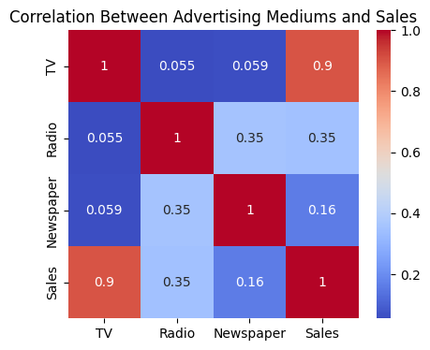
Exploratory Data Analysis
Key Findings:
TV and Radio advertising show strong positive correlation with sales
Newspaper advertising has comparatively lower influence
TV and Radio advertising expenditures show a stronger positive correlation with sales compared to Newspaper advertising.

Slide 5
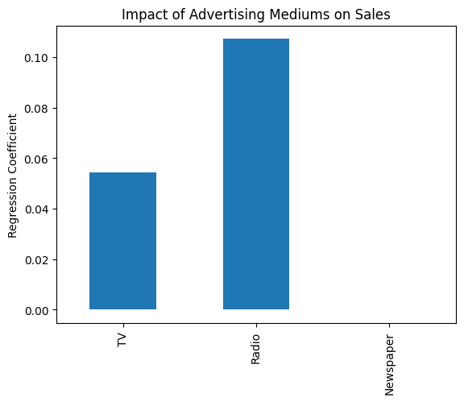
Linear Regression Model
Features used: TV, Radio, Newspaper
Model trained using 80–20 train-test split
Linear Regression applied to predict sales
Insight:
TV advertising has the highest impact on sales based on regression coefficients
Regression coefficients indicate that TV advertising has the highest impact on sales, followed by Radio, while Newspaper advertising contributes the least.

Slide 6
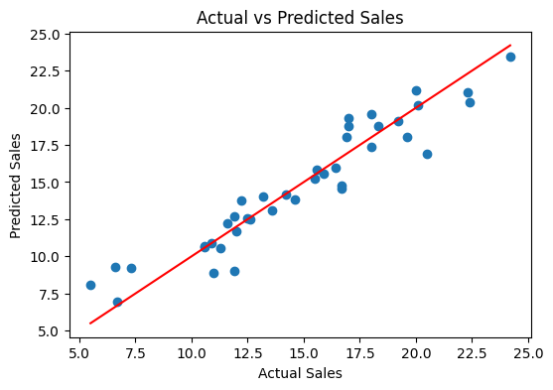
Model Performance & Prediction
Model evaluated using:
R² Score
RMSE
Good alignment between actual and predicted sales
Example Prediction:
TV = 200, Radio = 40, Newspaper = 50
→ Predicted sales computed using trained model
The linear regression model demonstrates good predictive performance, with predicted sales closely aligning with the actual sales values.

Slide 7
Conclusion & Observations
Linear Regression effectively models sales trends
TV advertising contributes most to sales growth
Normalization does not significantly change performance
Using only Radio and Newspaper reduces model accuracy
Conclusion: Advertising spend decisions can be optimized using regression-based prediction models.

